Slide 1
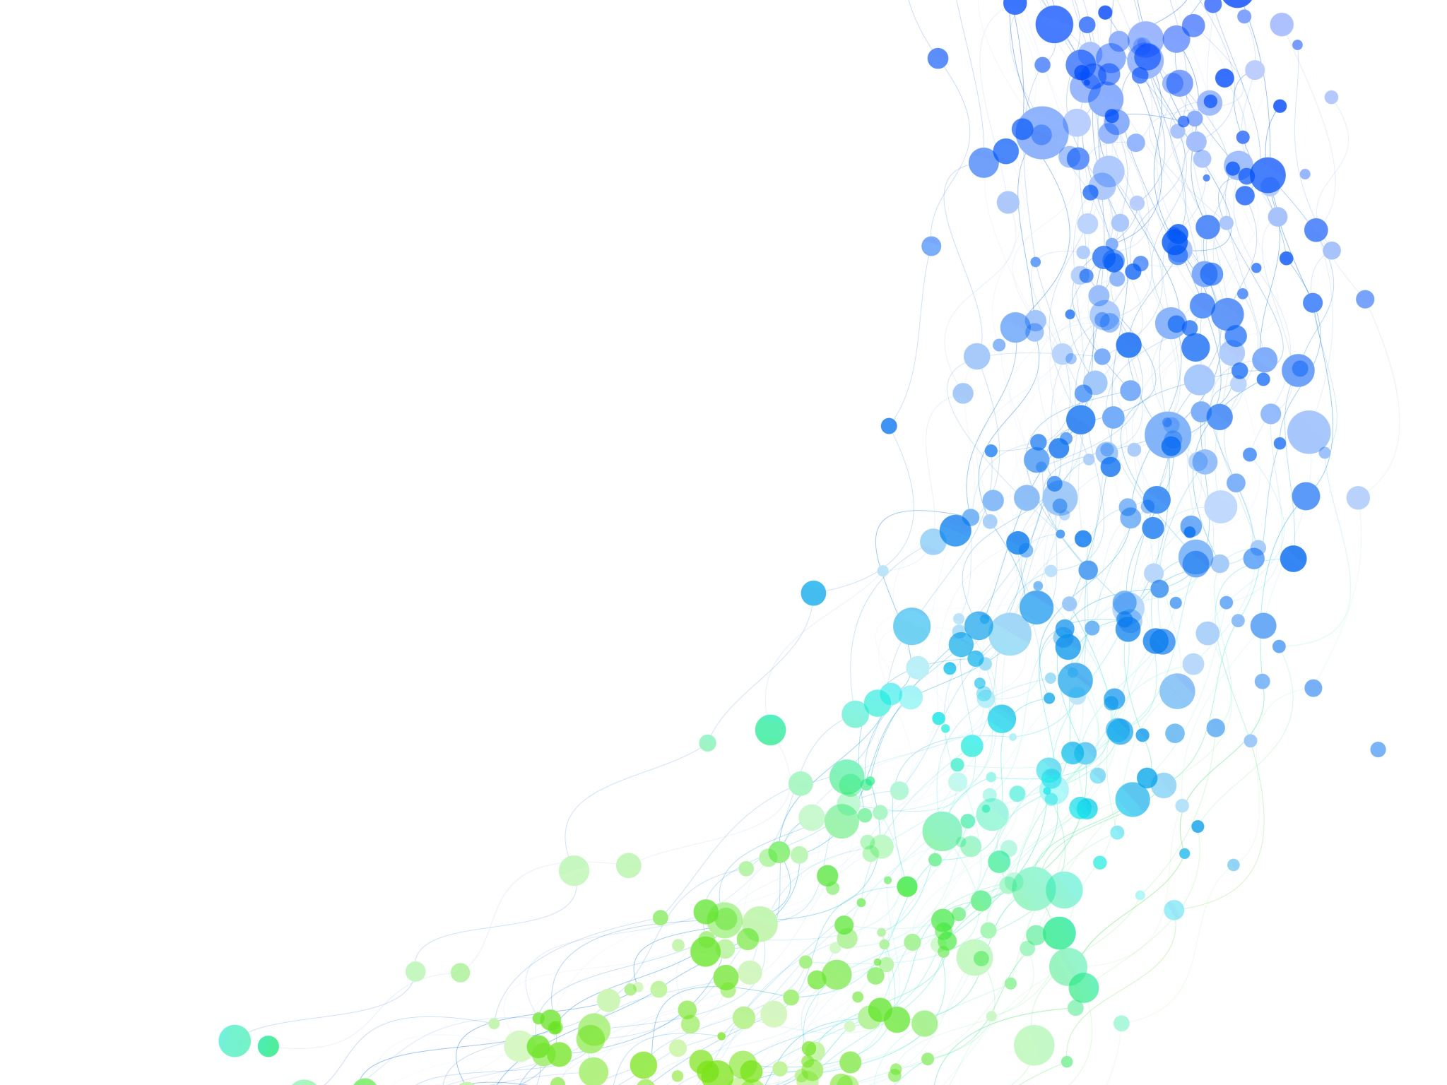



Phylogenetics in the –omics Era
Session Leader:
Dr. Jorge L. Pérez-Moreno
Mykles Lab, Department of Biology
Colorado State University

Slide 2
Lacking an annotated reference genome, how would you identify/characterize:
A locus deemed significant by a GWAS?
Differentially expressed genes?
BLAST/Diamond?
HMMER?

Slide 3
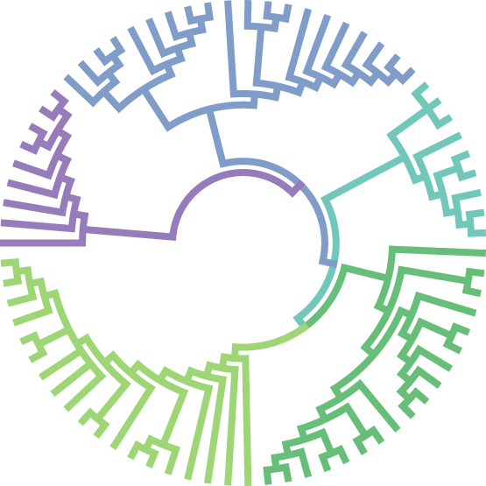
Phylogenetics!
“ the study of evolutionary relationships among living organisms”
genes
proteins
other biomolecules
populations
communities
Notes:
Phylogenetics is the scientific study of the evolutionary relationships among living organisms. It involves constructing and analyzing phylogenetic trees, which are diagrams that show the evolutionary relationships among species. Phylogenetic trees are based on the comparison of physical or molecular characteristics of different organisms, and they can be used to infer the evolutionary history and relationships among different groups of organisms. Phylogenetics is a key tool in evolutionary biology, and it has a wide range of applications, including in the study of the evolution of diseases, the identification of new species, and the analysis of gene function.

Slide 4

Phylogenetic methods are a key toolbox in biology
… and are often overlooked
Don’t make the sad crab sadder
viral evolution, epidemiology
taxonomy / systematics
gene / protein function
ancestral state reconstruction

Slide 5
Phylogenetic inference in 5 simple steps
Choose your data
Align the sequences
Test models of evolution
Build a phylogenetic tree
Interpret the results

Slide 6
Phylogenetic inference in 5 simple steps
Choose your data
Align the sequences
Test models of evolution
Build a phylogenetic tree
Interpret the results
Data must be relevant to research question
Possible sources:
Literature
Public databases (e.g., Genbank)
Specialized repositories (e.g., Flybase)
In-house datasets
Bad / insufficient data
=
Bad phylogenies
=
Erroneous inferences
Notes:
The first step in conducting a phylogenetic analysis is to choose the data that you will use. This could be a set of DNA or protein sequences, or other types of data such as morphological or behavioral traits. It is important to choose a data set that is relevant to the research question you are trying to answer. For example, if you are interested in the evolution of a particular gene, you might choose to use a set of sequences for that gene from a variety of different organisms.

Slide 7
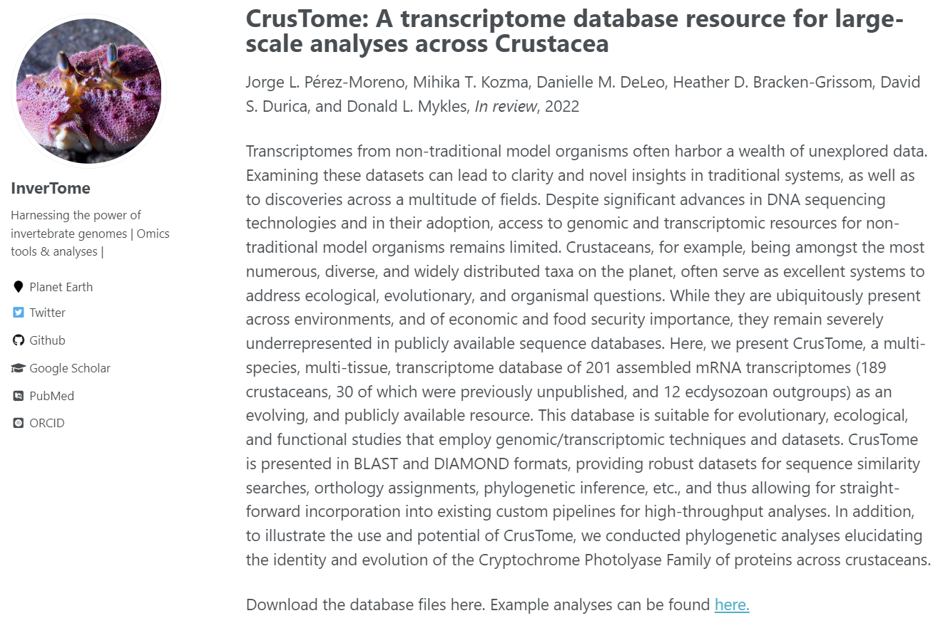
Phylogenetic inference in 5 simple steps
Choose your data
Align the sequences
Test models of evolution
Build a phylogenetic tree
Interpret the results

Slide 8
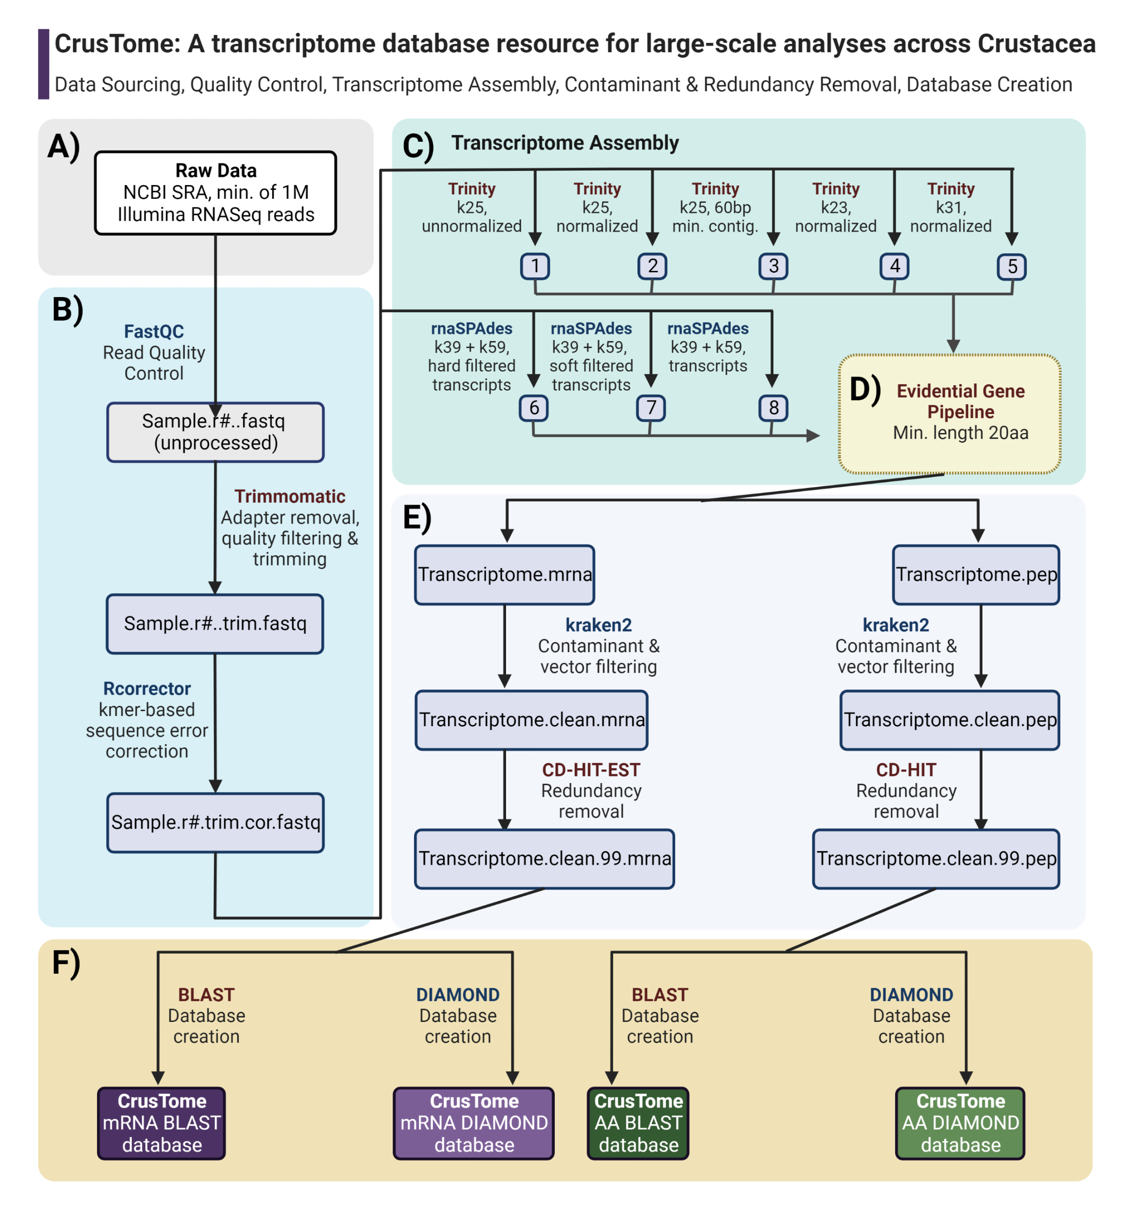
Phylogenetic inference in 5 simple steps
Choose your data
Align the sequences
Test models of evolution
Build a phylogenetic tree
Interpret the results

Slide 9

Choose your data
Align the sequences
Test models of evolution
Build a phylogenetic tree
Interpret the results

Slide 10


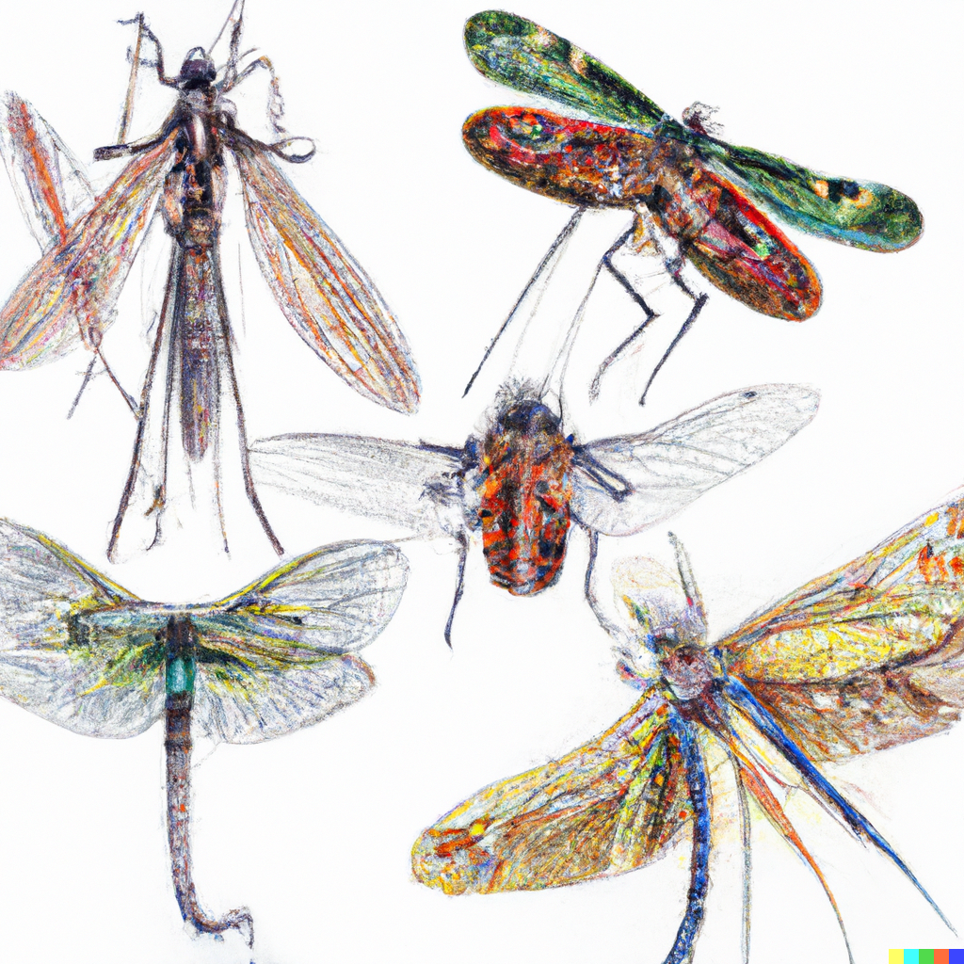
Phylogenetic inference in 5 simple steps
Choose your data
Align the sequences
Test models of evolution
Build a phylogenetic tree
Interpret the results
Transcriptomes
(multiple tissues)
Genomes
Predicted Transcriptomes
Genomes
Predicted Transcriptomes
jorgepm@colostate.edu

Slide 11
Phylogenetic inference in 5 simple steps
Choose your data
Align the sequences
Test models of evolution
Build a phylogenetic tree
Interpret the results
Searching for DATA
Keywords
Sequence similarity
Profile
e.g., NCBI
e.g., BLAST / Diamond
e.g., HMMER / HHsuite
Annotations
Fast & Efficient
Good sensitivity and specificity
Metadata
Widely applicable
Inefficient
Large Databases
Distant Homology
Dependent on annotated reference sequences
Less sensitive
Computationally intensive
Dependent on data curation
Requires multiple references
Notes:
Sequence similarity searches involve searching a database of sequences for those that are similar to a given query sequence. These searches are typically based on the sequence alignment algorithms, which align the query sequence with the sequences in the database and score the alignment based on the similarity of the sequences. Sequence similarity searches are fast and efficient, and they can be used to identify related sequences and to infer evolutionary relationships. However, they can be less sensitive than other methods and may miss some related sequences.
Profile searches, on the other hand, involve searching a database of sequences for those that match a given profile or pattern. A profile is a representation of the characteristics of a group of related sequences, and it is typically constructed by aligning a group of known sequences and calculating the frequency of each amino acid or nucleotide at each position in the alignment. Profile searches are more sensitive than sequence similarity searches and are better at identifying related sequences that are distantly related or have undergone significant changes. However, they can be slower and more computationally intensive than sequence similarity searches.

Slide 12
Phylogenetic inference in 5 simple steps
Choose your data
Align the sequences
Test models of evolution
Build a phylogenetic tree
Interpret the results
Data mining using sequence similarity / alignment methods
Recursive BLAST
Perform BLAST search
Use results of 1st search as input for second search
Repeat iteratively until no more new sequences are added
Filter by inclusion threshold (Bitscore, E-value, etc.)
E.g., https://github.com/torkian/blast-QC
Notes:
Recursive BLAST searches are a method used to identify sequences that are similar to a given query sequence in a database. They involve performing a sequence similarity search using the BLAST algorithm and then using the results of the search to identify additional sequences that are similar to the query sequence. The process is repeated iteratively, with the additional sequences being used as new query sequences in subsequent searches. This allows the search to be extended to more distantly related sequences, and it can be an effective way to identify related sequences that might not be identified by a single BLAST search. Recursive BLAST searches are particularly useful for identifying sequences that are distantly related to the query sequence or have undergone significant changes.

Slide 13


Phylogenetic inference in 5 simple steps
Choose your data
Align the sequences
Test models of evolution
Build a phylogenetic tree
Interpret the results
Data mining using sequence similarity / alignment methods
Inclusion threshold can be determined by plotting results
# Iteration vs. new hits
Hit rank vs. bit score
Notes:
Recursive BLAST searches are a method used to identify sequences that are similar to a given query sequence in a database. They involve performing a sequence similarity search using the BLAST algorithm and then using the results of the search to identify additional sequences that are similar to the query sequence. The process is repeated iteratively, with the additional sequences being used as new query sequences in subsequent searches. This allows the search to be extended to more distantly related sequences, and it can be an effective way to identify related sequences that might not be identified by a single BLAST search. Recursive BLAST searches are particularly useful for identifying sequences that are distantly related to the query sequence or have undergone significant changes.

Slide 14
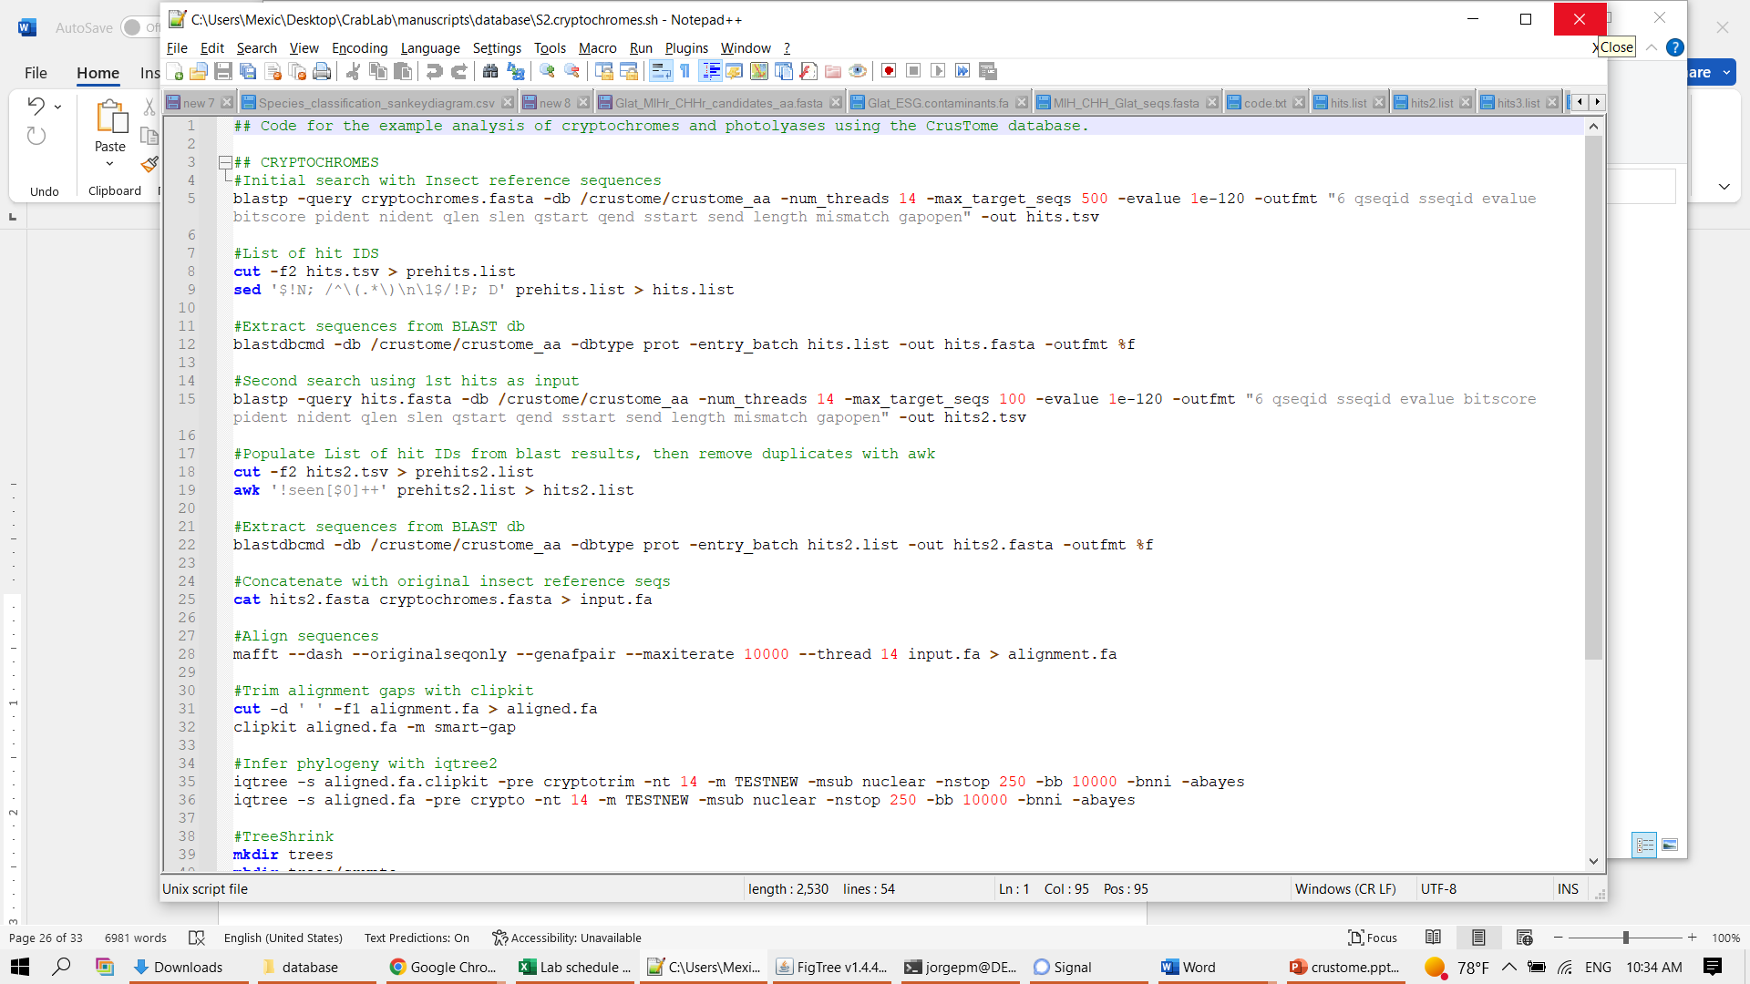
Phylogenetic inference in 5 simple steps
Choose your data
Align the sequences
Test models of evolution
Build a phylogenetic tree
Interpret the results
Data mining using sequence similarity / alignment methods

Slide 15
Phylogenetic inference in 5 simple steps
Choose your data
Align the sequences
Test models of evolution
Build a phylogenetic tree
Interpret the results
Data mining using sequence similarity / alignment methods
See example output at:
SICB2023_Workshop/datasets/02/

Slide 16
Phylogenetic inference in 5 simple steps
Choose your data
Align the sequences
Test models of evolution
Build a phylogenetic tree
Interpret the results
Data mining using sequence similarity / alignment methods
PSI-BLAST
Position-Specific Iterated BLAST
psiblast -query input_sequence.fa -db nr \
-out output.txt -outfmt 6 -evalue 1e-5 \
-num_iterations 3 -num_threads 4

Slide 17
Phylogenetic inference in 5 simple steps
Choose your data
Align the sequences
Test models of evolution
Build a phylogenetic tree
Interpret the results
Data mining using Hidden Markov Models
HMM = statistical model that consists of a set of states, transitions between states, and emissions from states.
In the genomic context,
states = a particular nucleotide or amino acid residue
Transitions/emissions = likelihood of one state transitioning to another
Notes:
An HMM is a statistical model that consists of a set of states, transitions between states, and emissions from states. In the context of genomic data, each state represents a particular nucleotide or amino acid, and the transitions and emissions represent the likelihood of one state transitioning to another or emitting a particular symbol.

Slide 18
Phylogenetic inference in 5 simple steps
Choose your data
Align the sequences
Test models of evolution
Build a phylogenetic tree
Interpret the results
Data mining using Hidden Markov Models
Recursive searches are also possible
See example pipeline at:
SICB2023_Workshop/datasets/02/hmm2phylo.sh
TIAMMAt!
Notes:
An HMM is a statistical model that consists of a set of states, transitions between states, and emissions from states. In the context of genomic data, each state represents a particular nucleotide or amino acid, and the transitions and emissions represent the likelihood of one state transitioning to another or emitting a particular symbol.

Slide 19
Phylogenetic inference in 5 simple steps
Genomes!
Choose your data
Align the sequences
Test models of evolution
Build a phylogenetic tree
Interpret the results
NCBI Datasets command line tools
https://www.ncbi.nlm.nih.gov/datasets/docs/v1/download-and-install/
Download Genome in FASTA format + gene models in GFF/GTF format
Notes:
An HMM is a statistical model that consists of a set of states, transitions between states, and emissions from states. In the context of genomic data, each state represents a particular nucleotide or amino acid, and the transitions and emissions represent the likelihood of one state transitioning to another or emitting a particular symbol.

Slide 20
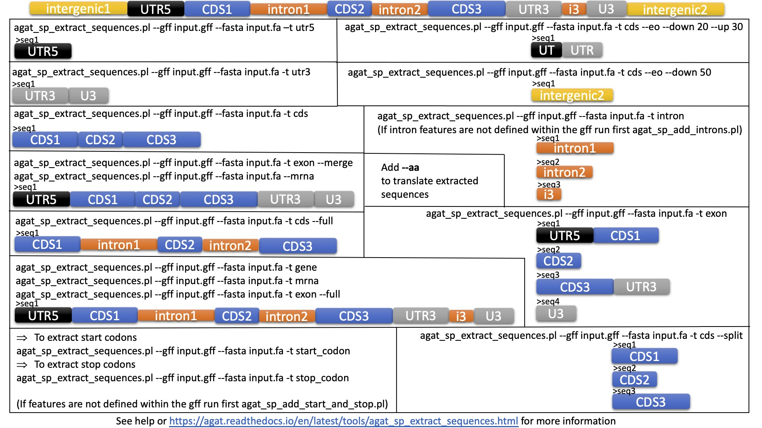
Phylogenetic inference in 5 simple steps
Genomes!
Choose your data
Align the sequences
Test models of evolution
Build a phylogenetic tree
Interpret the results
https://github.com/NBISweden/AGAT
Notes:
An HMM is a statistical model that consists of a set of states, transitions between states, and emissions from states. In the context of genomic data, each state represents a particular nucleotide or amino acid, and the transitions and emissions represent the likelihood of one state transitioning to another or emitting a particular symbol.

Slide 21
Phylogenetic inference in 5 simple steps
Algorithm/Software Package | Pros | Cons
Clustal (Clustal Omega) | Widely used and well-established Can handle large numbers of sequences | Can be slow for very large alignments May not produce the most accurate alignments for certain types of sequences
MAFFT | Fast and efficient Can handle large numbers of sequences Many options and parameters to optimize | Default settings may not produce the most accurate alignments for certain types of sequences Great options but Not so well documented
MUSCLE | - Fast and efficient | May not produce the most accurate alignments for certain types of sequences
T-Coffee | - Can produce high-quality alignments for certain types of sequences | May be slower than some other algorithms May not perform as well for certain types of sequences
Choose your data
Align the sequences
Test models of evolution
Build a phylogenetic tree
Interpret the results

Slide 22
Phylogenetic inference in 5 simple steps
Choose your data
Align the sequences
Test models of evolution
Build a phylogenetic tree
Interpret the results
MAFFT
Personal recommendation
Good choice of alignment algorithms
Noteworthy methods:
- MAFFT-Homologs
- MAFFT-DASH

Slide 23
Phylogenetic inference in 5 simple steps
Choose your data
Align the sequences
Test models of evolution
Build a phylogenetic tree
Interpret the results
Compare alignments!
E.g., https://github.com/TS404/AlignStat

Slide 24
Phylogenetic inference in 5 simple steps
Choose your data
Align the sequences
Test models of evolution
Build a phylogenetic tree
Interpret the results
Extremely important!
Wrong model choice = erroneous/biased results
Do model testing,
jModelTest
ProtTest
ModelFinder
Some phylogenetics software packages include model testing, i.e., IQTree

Slide 25
Phylogenetic inference in 5 simple steps
Choose your data
Align the sequences
Test models of evolution
Build a phylogenetic tree
Interpret the results
It’s TREE TIME
Several methods and algorithms. Where to start?
Choice depends on nature of DATA and QUESTION
No solution is fit for all scenarios

Slide 26
Phylogenetic inference in 5 simple steps
Algorithm | Strengths | Weaknesses | Best use cases | Software packages
Bayesian inference | Can incorporate uncertainty into estimates | Computationally intensive | Complex or uncertain evolutionary scenarios | MrBayes, BEAST, MCMCtree
Maximum likelihood | Makes precise estimates | Sensitive to errors in data | Large amounts of data and well-defined evolutionary scenarios | IQTree, RAxML, PhyML
Neighbor-joining | Fast and efficient | Less accurate for complex evolutionary scenarios | Large phylogenies quickly | ClustalW, MEGA
Maximum parsimony | Less sensitive to errors in data | Less accurate for large amounts of data or well-defined evolutionary scenarios | Noisy or missing data | PAUP*, PHYLIP
UPGMA | Fast | Less accurate for complex evolutionary scenarios | Large phylogenies quickly | PHYLIP
Choose your data
Align the sequences
Test models of evolution
Build a phylogenetic tree
Interpret the results
Notes:
"Bayesian inference is a method for estimating the likelihood of an event based on prior knowledge and new data
Maximum likelihood is a method for estimating the parameters of a statistical model that are most likely to have produced the observed data. It can be used to construct phylogenies by maximizing the likelihood of the data given a particular evolutionary scenario
Neighbor-joining is a method for constructing phylogenies that is based on the principle of minimizing the total length of the branches on the tree. It works by iteratively adding new species to the tree based on their distance from the other species.
Maximum parsimony is a method for constructing phylogenies that is based on the principle of minimizing the number of evolutionary changes required to explain the data. It works by identifying the minimum number of changes required to explain the data and constructing a phylogeny based on this information.
UPGMA (Unweighted Pair Group Method with Arithmetic Mean) is a method for constructing phylogenies that is based on the principle of grouping species based on their similarity. It works by starting with a set of unconnected species and iteratively adding new species to the tree, based on the similarity of their DNA sequences or other characteristics.

Slide 27
Phylogenetic inference in 5 simple steps
Choose your data
Align the sequences
Test models of evolution
Build a phylogenetic tree
Interpret the results
I. Look at the tree topology
II. Identify the root of the tree
III. Look for monophyletic groups
IV. Identify the branches
V. Look for bootstrap values
Notes:
1. Look at the tree topology: The topology of a phylogenetic tree refers to the overall shape and structure of the tree. The tree should show the relationships between the different groups being studied, with the most closely related groups being located closer to each other on the tree.
2. Identify the root of the tree: The root of the tree represents the common ancestor of all the groups being studied. It is usually not labeled on the tree, but can be identified by looking for the point where all the branches of the tree originate.
3. Look for monophyletic groups: A monophyletic group is a group that includes an ancestral species and all of its descendants. Monophyletic groups are often referred to as "clades." On a phylogenetic tree, a clade is represented by a branch that includes all the descendants of a particular ancestor.
4. Identify the branches: The branches of the tree represent the evolutionary relationships between the different groups being studied. The length of the branches can indicate the amount of evolutionary change that has occurred within a group.
5. Look for bootstrap values: Bootstrap values are a measure of the statistical support for a particular branch or clade on the tree. A high bootstrap value (usually over 70%) indicates that the branch or clade is well-supported by the data, while a low bootstrap value indicates that the support is weaker.

Slide 28
So I have a phylogeny… now what?

Slide 29
So I have a phylogeny… now what?
Molecular clock analyses / Divergence time estimation
Ancestral State Reconstruction
Phylogenetic Regression
Phylogenetic Signal Analysis
E.g., HyPhy, RASP4, Mesquite
E.g., PAUP, R packages: ape, phylolm, geiger
E.g., PAUP, R packages: phylosignal, picante, geiger
E.g., BEAST, PAML
Phylogenetic PCA
Diversification Analyses
Phylogenetic Mixed Models
R package phytools
R package phytools
MCMCtree, r packages pglmm, phyr, lmer

Slide 30

Other prospects
Machine Learning
*Identify patterns
*Classify data
*Make inferences and predictions
Function
Structure
HGT
Gene duplication
Taxonomy
Imputation
DEPP
(microbial phylogenetic placement)
S4Pred
(secondary structural prediction)
Deeptimelearning
https://github.com/JakubVoz/deeptimelearning (diversification)

Slide 31


Slide 32

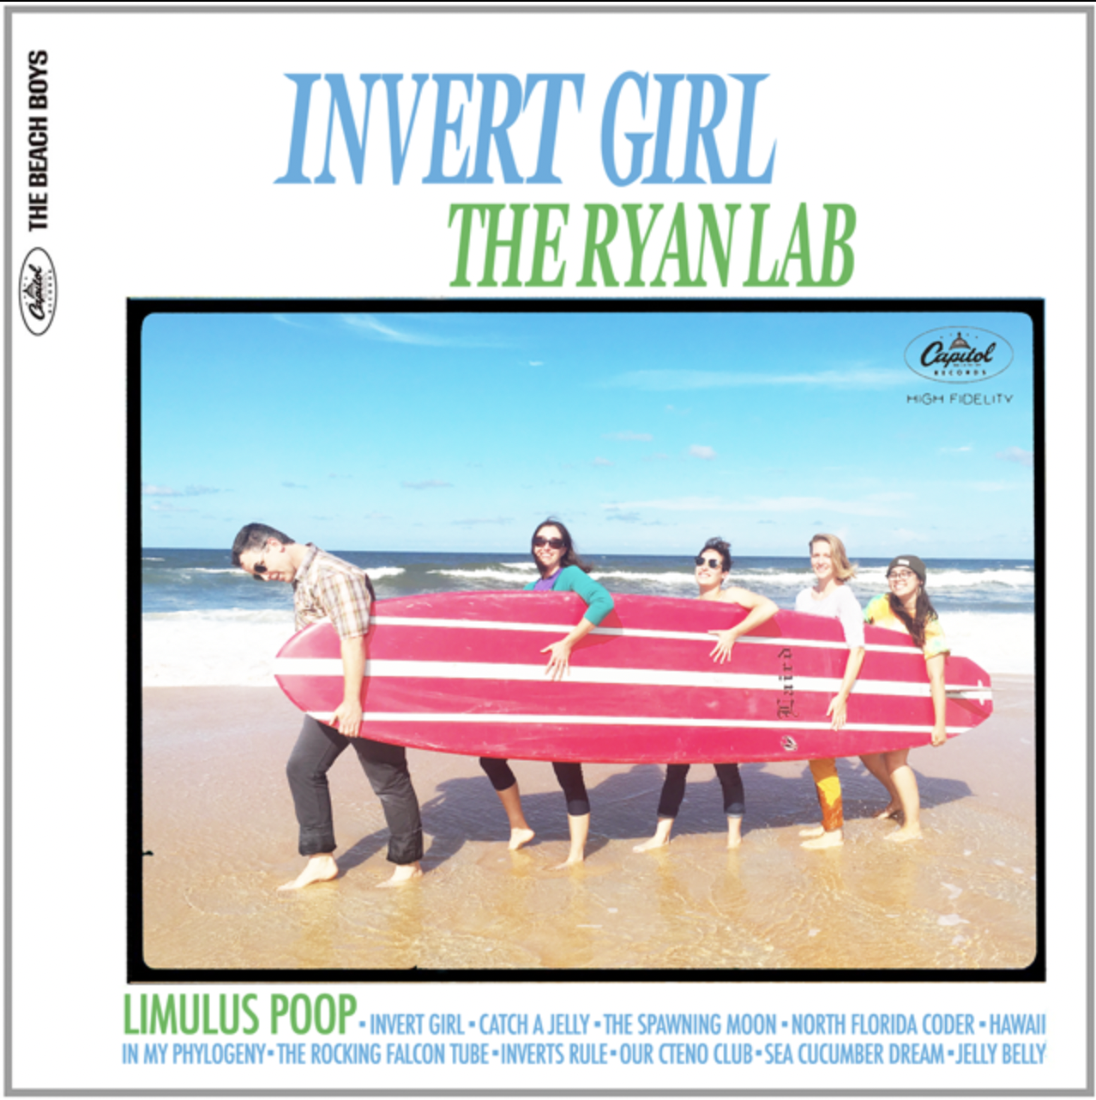

Orthology Inference & Determining Positive Selection of Genes
Session Leaders:
Dr. Joseph F. Ryan
The Whitney Laboratory for Marine Bioscience
University of Florida
Dr. Scott Santagata
Department of Biological and Environmental Sciences
Long Island University

